Slide 1
On Target Contractor’s Blueprint Chart Your Course to Business Success
On Target Business Intensive: Session 9

Slide 2
Implementation Steps so far
Session 1
Create a working draft of your Mission Statement
Create a working draft of your 1 and 5 year Vision
Answer the 10 questions on the handout
Session 2
Review your own financial statements and chart of accounts with what you learned in Session 2
Session 3
Create a budget for 2013 (or at least the last quarter)
If you already have a budget, review and revise as needed
Use the cash flow projection model (at the bottom of the budget tool)

Slide 3
Implementation Steps (cont.)
Session 4
Determine your breakeven point for your 2013 budget
Annual
For the month of October 2013
Define Target Market
Do a Competition Analysis
Session 5
Fill in information for Target Markets, Competition and Marketing Strategy (Marketing Plan – Parts 1, 2, 3)
Create a Marketing Budget using the template
Session 6
Outline Customer Communications Plan

Slide 4
Implementation Steps (cont.)
Session 7
Sales & Marketing
Set Sales Goals
Start Tracking Sales and Marketing
Job Costing
Start Job Costing every job if you aren’t already
Implement a system to track job profitability over time to measure progress
Coach foremen to improve
Session 8
Review Job Process Outline and Job Process Checklist
Customize Checklist for your company
Start to implement a more organized approach to your job process – add structure a piece at a time
4

Slide 5
Agenda for today
Recap last week – Questions
Company Meetings

Slide 6
Effective Company Meetings
Notes:
How to Make Company Meetings Really Work for Your Business
(First published in Contractor Power Magazine)
With all the bad press that meetings get for being a waste of time, it is true that good meetings can very effective by getting your team more engaged and involved in the process of delivering your product or service, as well as providing them with needed guidance to perform their jobs better.
Be consistent
The first rule of successful company meetings is consistency. Read the previous sentence again. I have had contractors tell me over and over that they don’t get good results from their company meetings. When I ask how often they have meetings, more often than not the response is something like this: “We used to have them every two weeks but we haven’t had one in several months.”
For those who don’t currently have company meetings in place, you may well be wondering how taking time away from the myriad tasks at hand to hold meetings with your team can benefit your company. I find this to be especially true when we talk about taking time to meet with field employees who could be out generating income producing work. Following are some good reasons why you should have meetings:
Increase Efficiency
It may sound like an oxymoron, but meetings actually can increase efficiency, providing you use the time wisely. A meeting is a great time for team members who work very efficiently to demonstrate techniques and processes to others as well as creating an opportunity for team members to brainstorm on the best way to do something.
Technical Training
Providing technical training in the processes and techniques used in your craft advance the learning for team members, giving you the opportunity to add new skills to their repertoire as well as ensure consistency in the training throughout the company.
Safety Training
Safety training is always necessary as well as mandated in many cases. Providing safety training serves as a good reminder to team members; it often seems to be easy for employees to forget to use basic safety measures, as many business owners have experienced!
Keep the Team Informed
As a business owner, you are working on so many initiatives; you may forget that not everyone in the company is aware of all the new things that are happening. Perhaps you have added a new target market, are planning to add a new type of service or are launching a new marketing campaign. An informed employee can promote your business better and feels part of the team.
Monitoring Key Performance Indicators
Smart businesses have a number of critical success factors that they monitor consistently. Effective meeting leaders make use of key performance indicators gathered by the company’s communication and data systems to promote learning and develop next action steps.

Slide 7
Purpose of meetings
Get your team more engaged and involved in the process of delivering your product or service
Provide your team with the guidance they need to perform their jobs better
Give and receive information in a more timely way
Keep your finger on the pulse of your business
Notes:
With all the bad press that meetings get for being a waste of time, it is true that good meetings can very effective by getting your team more engaged and involved in the process of delivering your product or service, as well as providing them with needed guidance to perform their jobs better.

Slide 8
Rule # 1: Be consistent
The first rule of successful company meetings is consistency. Read the previous sentence again.
Notes:
I have had contractors tell me over and over that they don’t get good results from their company meetings. When I ask how often they have meetings, more often than not the response is something like this: “We used to have them every two weeks but we haven’t had one in several months.”
For those who don’t currently have company meetings in place, you may well be wondering how taking time away from the myriad tasks at hand to hold meetings with your team can benefit your company. I find this to be especially true when we talk about taking time to meet with field employees who could be out generating income producing work. Following are some good reasons why you should have meetings:

Slide 9
Meetings Increase Efficiency
Notes:
It may sound like an oxymoron, but meetings actually can increase efficiency, providing you use the time wisely. A meeting is a great time for team members who work very efficiently to demonstrate techniques and processes to others as well as creating an opportunity for team members to brainstorm on the best way to do something.

Slide 10
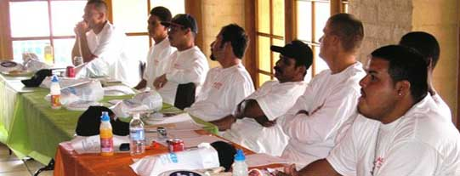
Technical Training
Notes:
Providing technical training in the processes and techniques used in your craft advance the learning for team members, giving you the opportunity to add new skills to their repertoire as well as ensure consistency in the training throughout the company.

Slide 11
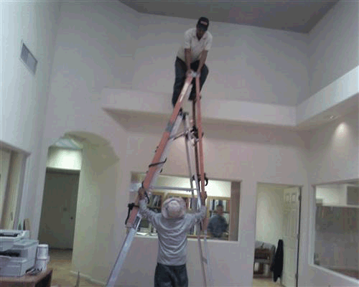
Safety Training
So your crews don’t try stunts like this…
Notes:
Safety training is always necessary as well as mandated in many cases. Providing safety training serves as a good reminder to team members; it often seems to be easy for employees to forget to use basic safety measures, as many business owners have experienced!

Slide 12
Keep the Team Informed
Notes:
As a business owner, you are working on so many initiatives; you may forget that not everyone in the company is aware of all the new things that are happening. Perhaps you have added a new target market, are planning to add a new type of service or are launching a new marketing campaign. An informed employee can promote your business better and feels part of the team.

Slide 13
Monitor Key Performance Indicators
Notes:
Smart businesses have a number of critical success factors that they monitor consistently. Effective meeting leaders make use of key performance indicators gathered by the company’s communication and data systems to promote learning and develop next action steps.

Slide 14
Best Practice Meetings
Field Team Meetings
Foremen/Crew Leader Meetings
Management/Administrative Team Meetings
Sales Meetings
Special Meetings
Notes:
Best Practice Meetings
There are several types of meetings that I believe are “best practice” for contractors. For each of them I propose some key agenda items as well as my suggestions for frequency and duration of each type of meeting

Slide 15
Field Team Meetings
Consistent meetings for your field crews provide the vehicle for both technical training and safety training..
Notes:
Consistent meetings for your field crews provide the vehicle for both technical training and safety training. Certainly both of these can and should be covered in on the job training or jobsite meetings as well. Unless you have a project manager who is communicating with all of the crews in well planned and executed job site training, you will be better served by regularly scheduled field team meetings at your shop.

Slide 16
Field Team Meetings
Agenda:
Brief overview of goals for the month
Administrative training
Safety training
Technical training
Frequency: Once a month.
Duration: 45 minutes to 1 hour
Notes:
Agenda: Brief overview of goals for the month and how the team can help the company meet the goals. Safety training as mandated, considering a focus on areas of recent concern or upcoming relevance. Technical training, with, again, a focus on areas where you may have noted less than stellar performance on efficiency or quality of work, or use the time for training on new types of applications and techniques.
Frequency: Once a month.
Duration: 45 minutes to 1 hour

Slide 17
Foremen/Crew Leader Meetings
Foremen meetings keep you in closer touch with job progress and give your crew leaders an opportunity to develop as leaders and you a chance to coach them to greater success.
Notes:
Foremen meetings keep you in closer touch with job progress and give your crew leaders an opportunity to develop as leaders and you a chance to coach them to greater success.
Agenda: Overview of recently completed jobs and job costing, noting successes and challenges and what can be learned for better success on upcoming jobs. Foremen report on jobs in progress and how they are preparing for upcoming jobs.
Frequency: Once a week.
Duration: 45 minutes to 1 hour

Slide 18
Foremen/Crew Leader Meetings
Agenda:
Overview of recently completed jobs and job costing, noting successes and challenges and what can be learned for better success on upcoming jobs.
Foremen report on jobs in progress and how they are preparing for upcoming jobs.
Frequency: Once a week.
Duration: 45 minutes to 1 hour
Notes:
Foremen meetings keep you in closer touch with job progress and give your crew leaders an opportunity to develop as leaders and you a chance to coach them to greater success.
Agenda: Overview of recently completed jobs and job costing, noting successes and challenges and what can be learned for better success on upcoming jobs. Foremen report on jobs in progress and how they are preparing for upcoming jobs.
Frequency: Once a week.
Duration: 45 minutes to 1 hour

Slide 19
Management/Administrative Team Meetings
Consistent management meetings
Keep operations running smoothly
Enable you to deal with employee issues in a timely way
Keep your marketing plan on track
Improve cash flow by keeping you in touch with your financial position.
Notes:
Consistent management meetings keep operations running smoothly, enable you to deal with employee issues in a timely way, keep your marketing plan on track, and improve cash flow by keeping you in touch with your financial position.
Agenda: Review Administrative action plan and next steps, HR issues, Invoicing, Collections and Cash Flow.
Frequency: Once a week.
Duration: 1 hour

Slide 20
Management/Administrative Team Meetings
Agenda:
Review Administrative action plan and next steps,
HR issues
Invoicing
Collections, Payments and Cash Flow
Marketing actions
Frequency: Once a week.
Duration: 1 hour
Notes:
Consistent management meetings keep operations running smoothly, enable you to deal with employee issues in a timely way, keep your marketing plan on track, and improve cash flow by keeping you in touch with your financial position.
Agenda: Review Administrative action plan and next steps, HR issues, Invoicing, Collections and Cash Flow.
Frequency: Once a week.
Duration: 1 hour

Slide 21
Sales Meetings
Sales team meetings will help to keep your sales team, including the owner, on target for meeting their sales goals by reviewing their sales funnel and determining actions to generate more leads and sales conversions.
Notes:
Sales team meetings will help to keep your sales team, including the owner, on target for meeting their sales goals by reviewing their sales funnel and determining actions to generate more leads and sales conversions.
Agenda: Overview of sales funnel and follow-up actions, evaluation of lead flow, and determination of next actions to close jobs or generate more leads through networking or other marketing activities.
Frequency: Once a week.
Duration: 30 to 45 minutes

Slide 22
Sales Meetings
Agenda:
Overview of sales funnel and follow-up actions
Evaluation of lead flow
Determination of next actions to close jobs or generate more leads through networking or other marketing activities.
Frequency: Once a week.
Duration: 30 to 45 minutes
Notes:
Sales team meetings will help to keep your sales team, including the owner, on target for meeting their sales goals by reviewing their sales funnel and determining actions to generate more leads and sales conversions.
Agenda: Overview of sales funnel and follow-up actions, evaluation of lead flow, and determination of next actions to close jobs or generate more leads through networking or other marketing activities.
Frequency: Once a week.
Duration: 30 to 45 minutes

Slide 23
Special Meetings
Annual planning and budget meeting for the management team
Marketing strategy meetings
Board of directors meetings
Planning retreats
All shop meetings
Notes:
Special Meetings
In addition to the day to day company operations types of meetings, your company will be best served by scheduling what I call “altitude” types of meetings occasionally. These might include the following: Annual planning and budget meeting for the management team, marketing strategy meetings, and board of directors meetings. Some companies also schedule an off site management team retreat for a day or a weekend to accomplish their annual planning and strategy each year. If your budget is tight, you don’t need to make this an extravagance. You may be able to rent a boardroom at a local hotel fairly inexpensively for the day. It’s often more effective to get away from the day to day distractions and environment when doing your higher level planning.

Slide 24
Rule # 2 Have an Agenda
Put together an agenda for each meeting
Calendar the meetings
Hold meetings regardless of total attendance
Start and end on time
Stay on track
Notes:
Have an Agenda
The second rule of successful meetings is to have an agenda and a set time frame for beginning and ending the meeting. Having an agenda, even if it is three bullet points on a piece of paper is critical. Stick to covering the topics on the agenda and make sure to use the time appropriately to get through all the listed items. One of my clients who is very successful in running effective meetings has three rules that everyone can learn from:
The meeting is held at the calendared day and time even if someone must be absent – this includes the owner himself.
The meeting is a set length, and must start and end on time, regardless of whether there is more to discuss or someone is late.
Items for inclusion on the agenda must be submitted to the Office Manager before 5 PM on the day prior to the meeting. Any items not submitted will not be included in discussion unless there is unused time.
These rules may seem extreme but having strict parameters forces consistency and efficiency in meetings.

Slide 25
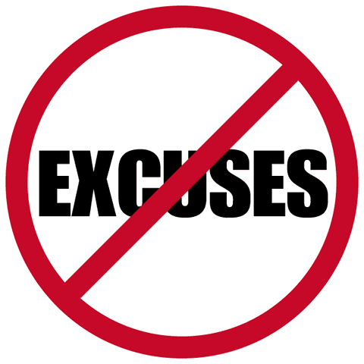
Excuses, excuses
Notes:
Excuses, excuses.
I hear many reasons from business owners for not holding meetings as intended. A primary reason is that the time doesn’t work for someone, that a key attendee (often the owner) has scheduled something else in direct conflict so the meeting has to be rescheduled, or that something “really important” came up. Another common reason is that nothing was prepared for a training session, so therefore, why hold a meeting? As a business owner, you set the tone – if the outcome of the meeting is important to you, then it will become important to the team. If on the other hand, you are inconsistent, the team gets the message that it isn’t all that important and you will lose commitment and buy-in from them, making it all the more difficult to re-engage them the next time.
The best thing you can do to start moving towards more effective meetings is to be realistic with yourself. You may want to start slower and set a meeting schedule that is less frequent than you think is ideal to give yourself the opportunity to succeed in your commitment.

Slide 26
Implementation Steps
Schedule a recurring company meeting
Create an agenda
Hold your first meeting

