Slide 1
Your
Business Plan
On Target Group Coaching

Slide 2
What we’ll talk about today
Why you are here - Purpose
What you are about - Mission
Where you want to go - Vision
Value Proposition
Business Model
SWOT
Goals and objectives
On Target Business
Notes:
What We’ll Cover Today
In that situation, would you say that the owner is running the business or that the business is running the owner? From what my clients say to me, it seems like the business is running them.
Now I could have started this presentation in any number of ways. Traditionally when talking about business plans people start off by saying how business plans are needed when people are looking for finance, or as a reality check for a new business idea. And that’s fair enough, they are used for those purposes - and a few other things as well which I’ll also mention later.
But I wanted to emphasize in particular that a business plan is a tool for giving you some control over your business to allow you to run it. Keep that in mind as we go through this seminar and just relate each of the parts of a business plan to how knowing that information could provide you with control over your business and not the other way around.

Slide 3
Why are you here?
We will start with your company direction, why you are in business, and what you want to achieve. Then we’ll look at your vision for the future of your company and then define the goals and objectives that will help you create that future.

Slide 4
Who are you?
What are you in business for?
What do you stand for?
What is your purpose?

Slide 5
Company Values
Provide guidelines on how to proceed as one pursues organizational purpose.
Answer the questions “What do I want to live by?” and “How?”
Describe behaviors that demonstrate that the value is being lived.
Notes:
Review company or organizational values.
(5 min.)

Slide 6
Values, Morals & Ethics
Values are deeply held beliefs that define for each of us what is right. They provide guidelines for our choices and actions.
Morals are rules or habits of conduct with reference to standards of right and wrong.
Ethics are the principles of conduct governing an individual or a profession, standards of social or professional behavior.

Slide 7
What is our Mission?
What is our reason for being?
What are our guiding principles?

Slide 8
Mission Statement
A clear statement of your company’s long-term mission. Try to use words that will help direct the growth of your company, but be as concise as possible.

Slide 9
What is your Business Model?
A business model describes the rationale of how an organization creates, delivers and captures value
What is your reason for existence?
What do you bring to the marketplace?
What is the structure of your operations?
How are you rewarded for what you do?

Slide 10
What business am I in?
What do I do?
What do I bring to the market?
  Value Proposition: The bundle of products and services that create value for a specific customer segment
Who are my target markets?
  Customer Segments: The different groups of people or organizations your business aims to reach and serve

Slide 11
Value Proposition
val·ue prop·o·si·tion
  noun
  value propositions, plural
  (in marketing) An innovation, service, or feature intended to make a company or product attractive to customers
Value proposition is a term rapidly replacing the popular business phrase "Unique selling proposition".A value proposition is an offer that describes the quantifiable benefit(s) that the individual(s) or organization(s) making the offer promise(s) to deliver. ...
Source: wikipedia.org
Notes:
The reason why your customers choose you over your competitor
Cater to the requirements of a customer segment
What value do we deliver to the customer?
Which one of our customer’s problems are we helping to solve?
What bundles of products and services are we offering to each customer segment

Slide 12
Core Competencies
What factors will make the company succeed?
What are your major competitive strengths?

Slide 13
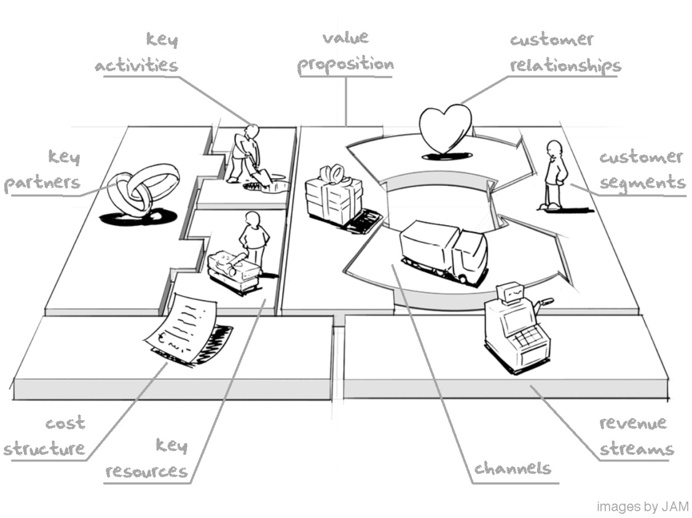
Business Model Map –
A Business Canvas
Source: Alexander Osterwalder, Business Model Generation

Slide 14

Where You Are Now
The big picture view of your business
Notes:
Business Profile - Where You Are Now
Every business plan has a section, whether it goes by the name of Business Profile or some other title, that gives a big picture view of the business and includes an overview of the industry and explains what is special about your business, as well as what factors are going to make it a success. And part of this will include a description of your current situation.
For startups this should be a short explanation that simply states whether you have a product, or simply an idea, and the stage you are at in its development. For existing businesses, this means explaining your background, current sales levels, your standing in the market and a number of other things that really make you focus on how good your business idea is or how saleable a product you actually have.

Slide 15
Where do I want to go?
What is my Vision for the company?
  Long term
  Short term

Slide 16
How do we get there from here?
What is your current situation - where are you now?
How do you see the business some time in the future - where do you want to get to?
What are your strategies for how you are going to get there?
What are your specific goals to be reached by particular dates so you can track your progress as you go?

Slide 17
Goals
One year goals
Five-year goals
  State specific measurable objectives
  State market share objectives
  State revenue/profitability objectives
What are your plans for the future of the business?
Growth? If so, at what rate and how will you achieve it?

Slide 18
Strategies
How are you going to go about achieving your goals?
What are the actions steps to carry out your strategies?
What are your time frames for these?

Slide 19
Reviewing Your Business
SWOT Analysis

Slide 20
The Need For Strategy
Business success doesn’t come from luck or by accident
Planning is necessary
Your Business Plan forms your strategy for success
SWOT is a technique for analyzing your business so you can come up with the most suitable strategies

Slide 21
SWOT analysis
Internal Assessment Of The Organization
Strengths
Weaknesses
SWOT
ANALYSIS
Opportunities
Threats
External Assessment Of The Environment

Slide 22
Scanning The Internal Environment
STRENGTH - As an organization what do we do well?
WEAKNESS - As an organization what could be our weaknesses or failures ?

Slide 23
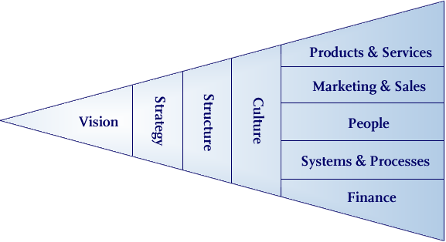
Strengths And Weaknesses – Looking Within

Slide 24
Opportunities & Threats –
Looking Outwards
OPPORTUNITIES - What possibilities exist in the marketplace that can help our business realize our vision?
THREATS - What can go wrong in our business because a particular situation exists in the marketplace that could prevent us from realizing our vision?

Slide 25
Scanning The External Environment
Competition
Industry
Technology
The Business
Customers
Business Environment
Shareholder Circumstances

Slide 26

On the road to becoming an
ON TARGET Business…

Slide 27
What is an On Target Business?
Works ON the business
A Leader with a visioN
Known for InTegrity
Accountable to yourself and your company
Applies best business pRactices
Growing personally and professionally
Committed to Excellence
Has an extensive neTwork

Slide 28
Leadership
Has a clear vision, purpose and values for self & company
Articulates these effectively to team so that team “buys in” to the leader’s vision, purpose and values
Has and is implementing an annual strategic plan
Has and is implementing a 3-5 year business plan
Delegates effectively!
Team members are developing along a career path
Owner can take time away from the business without negative results

Slide 29
Finance
Accounting system is fully & accurately functioning
Controls are in place to ensure accuracy
On Target Financial Monitoring is up to date and being used effectively as a business tool
Key Metrics are up to date and being used to keep your finger on the financial pulse of your business
Owner reviews Financial Data and Metrics at least monthly and takes action where indicated
An adequate credit line is in place
The business has a good accountant and banker who understand and effectively support the business goals
Company is profitable, solvent and able to finance its growth and reward stakeholders

Slide 30
Administration
Has functioning operating systems
  HR Systems – hiring & recruiting procedures, job descriptions, performance management system, employee manual
  Policies/Procedures for all key activities
  Technology/software are in place and being used effectively including effective network and backup systems
  Has an effective customer process flow with all employees “buying in” and implementing
  Has an Employee Training program
  Offers employee benefits & growth path to encourage long term employment for good employees
  Has a Performance Review process in place
Has an office/shop that is suitable for current & planned growth
Has appropriate support personnel to manage present & upcoming growth

Slide 31
Marketing & Sales
Has a Marketing Plan with the following components
  Marketing Strategy – with target markets, and strategy for each
  Marketing Budget - with breakdown for each strategy
  Marketing Timeline – when each strategy is to be launched or otherwise acted upon
Measures the ROI on each Marketing strategy
Has an effective system to stay in contact with customers and potential customers
Evaluates periodically, the target markets, niches and marketing strategies to ensure that they are still in line with current growth plans, market changes, and new initiatives
Invests in Education & Training for sales team (including mentoring by owners or other sales team)
Measures the effectiveness of sales team

Slide 32
Innovation
Growing personally and professionally
Looking for better ways achieve your business goals and to serve your target markets
  New products
  New services
  New methods of service delivery
  New marketing opportunities
  New ways to deliver your marketing message
  New ways that technology can serve your business
  New trends that serve your market
  New ways to differentiate your company

Slide 33
Rewards of being “On Target”
Become more profitable
Be able to reward shareholders and key employees
Achieve your business goals
Make timely changes to your strategy
Improve quality of life both personally and professionally
Develop a great support group and good friends with whom to celebrate your progress

Slide 34
Implementation Steps
  Create a working draft of your Mission Statement
  Create a working draft of your 1, 3 and 5 year Vision

